Slide 1
Data coach | Steel Data Challenge 3 Customer Insights
As the Customer Insights Analyst for 'The General Store', I am poised to delve deep into our customer data to unearth pivotal insights. With a keen eye on analytics, my mission is to decode the shopping behaviors, preferences, and patterns of our customers. The findings from this analysis will be instrumental in crafting data-driven strategies for our marketing team, ensuring that we not only meet but exceed our customer's expectations. Presented by : Sunil Kumar Pal

Slide 2
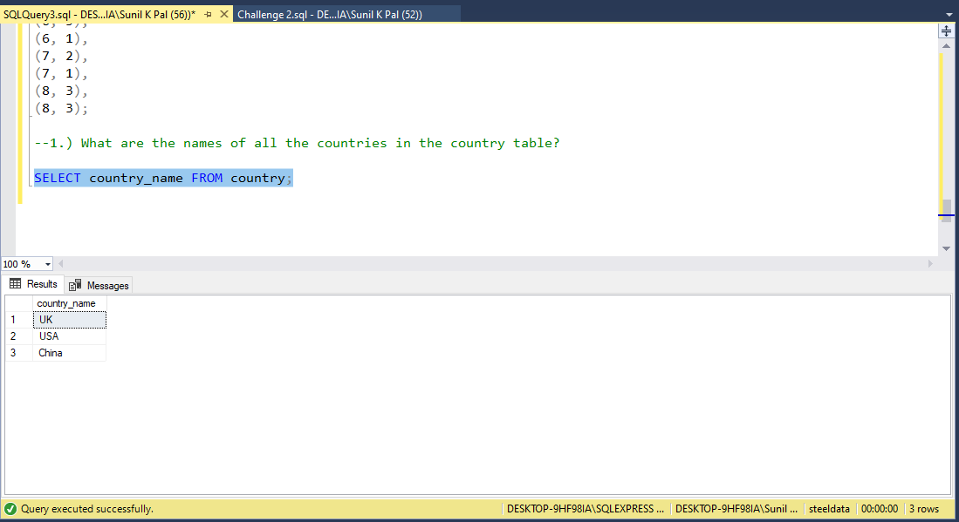
What are the names of all the countries in the country table?

Slide 3
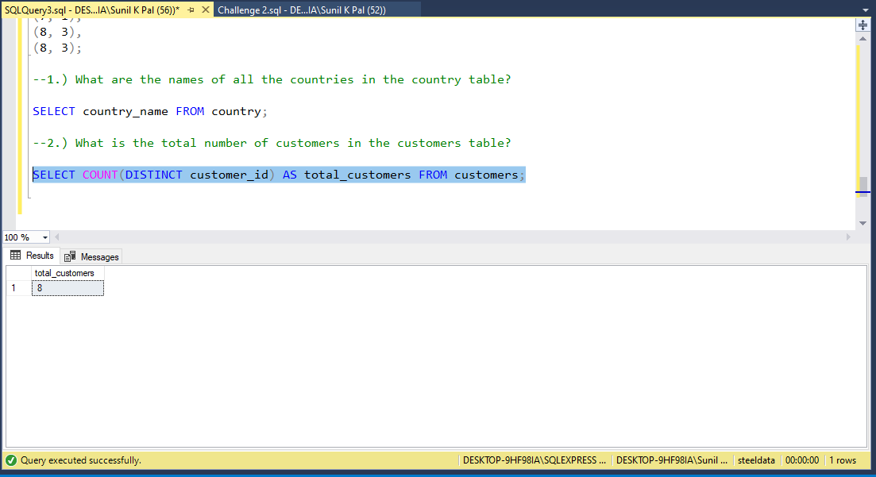
What is the total number of customers in the customers table?

Slide 4
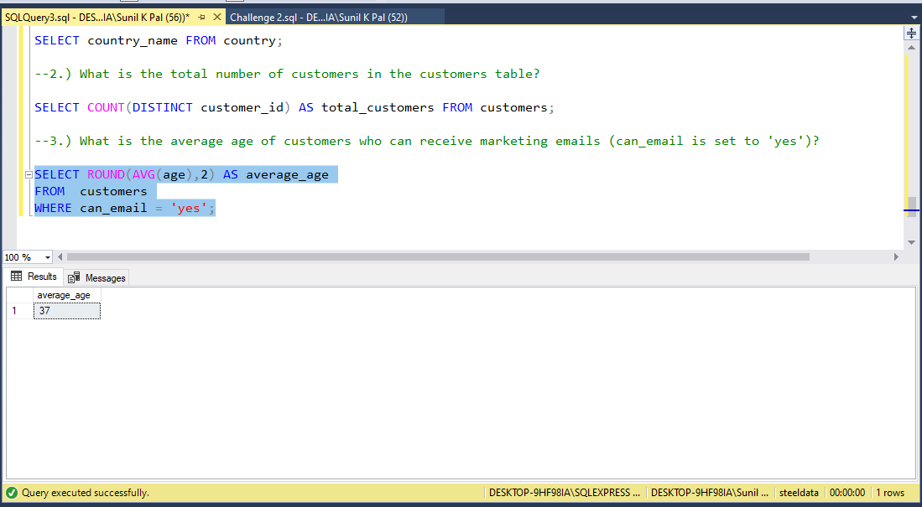
What is the average age of customers who can receive marketing emails (can_email is set to 'yes')?

Slide 5
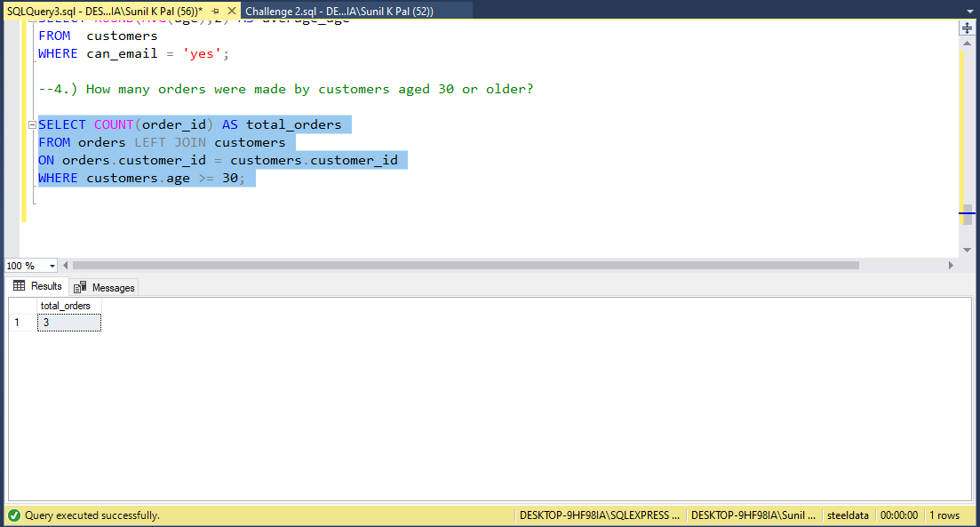
How many orders were made by customers aged 30 or older?

Slide 6
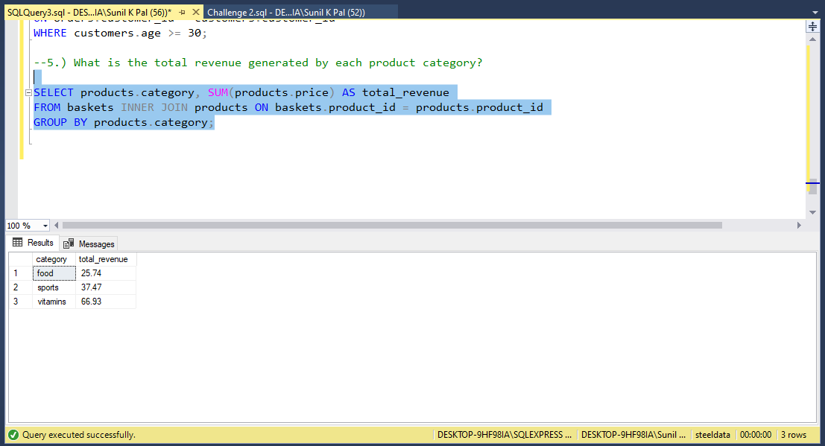
What is the total revenue generated by each product category?

Slide 7
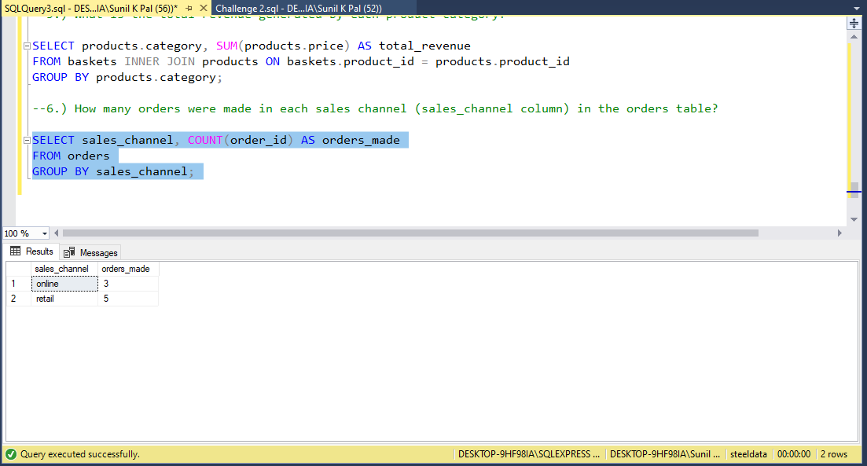
How many orders were made in each sales channel (sales_channel column) in the orders table?

Slide 8
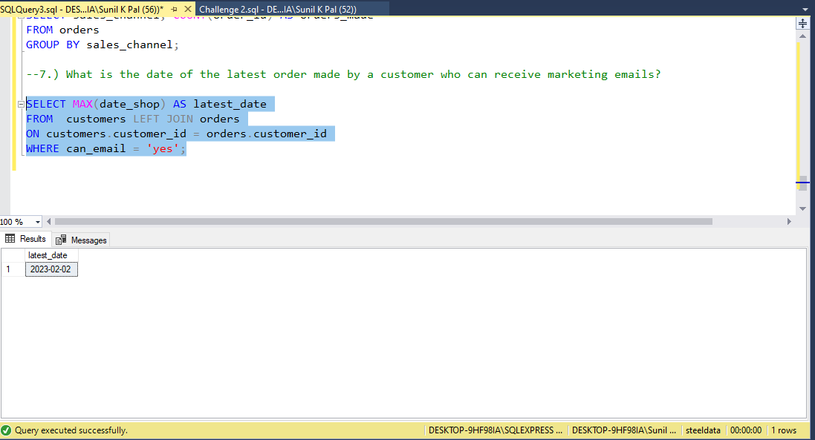
What is the date of the latest order made by a customer who can receive marketing emails?

Slide 9
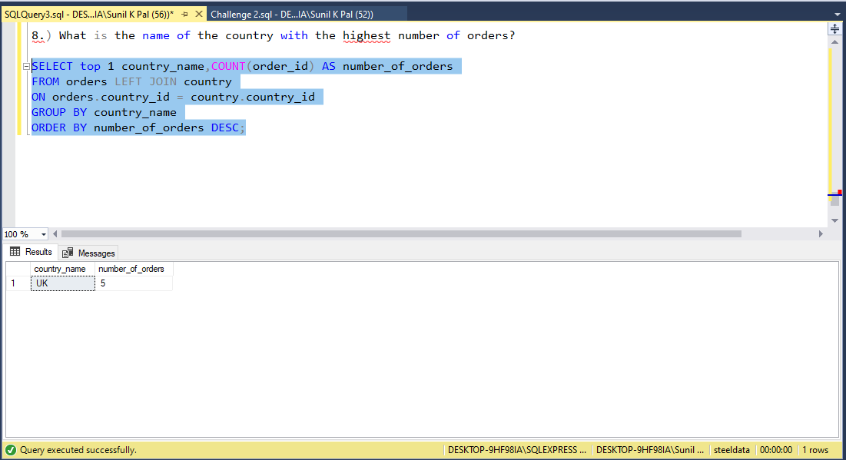
What is the name of the country with the highest number of orders?

Slide 10
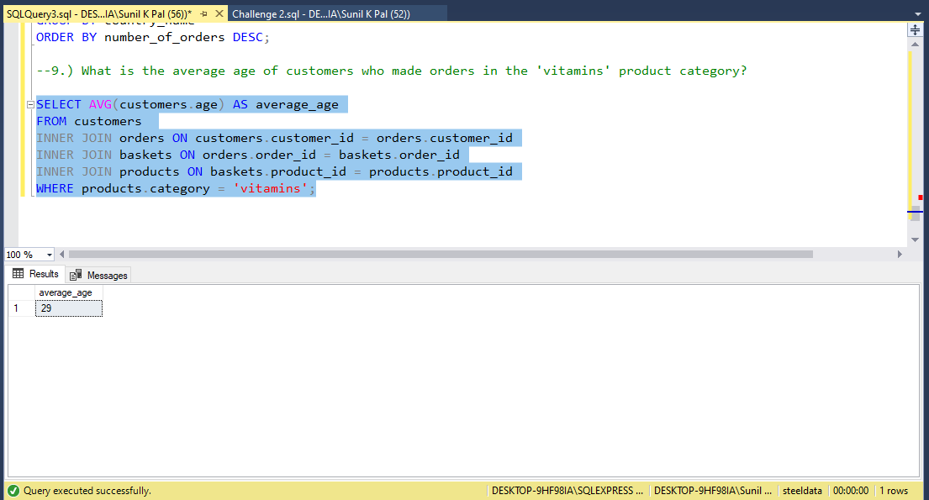
What is the average age of customers who made orders in the 'vitamins' product category?

Slide 11
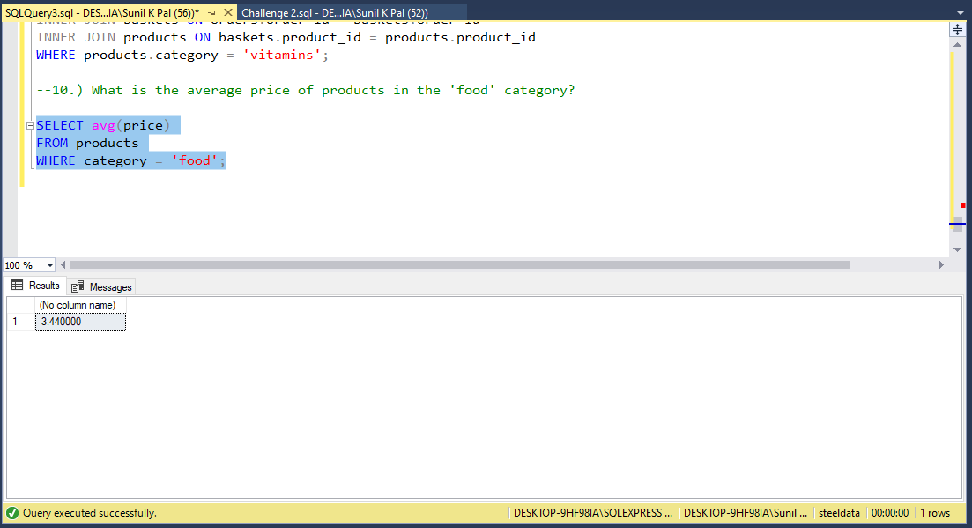
What is the average price of products in the 'food' category?

